Slide 1
Group A Streptococcus (GAS)
Corbin Matamoros

Slide 2
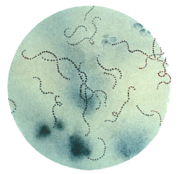
What is GAS? Part 1
Gram-positive bacteria that grows in chains
Has a thick peptidoglycan cell wall (20-80 nm thick polymer) [1]
Turns blue in the staining test developed by Hans Christian Gram [1]
Incubation period is approximately 2 to 5 days [2]
Most common in children 5-15 years old [3]
Communicable through saliva, coughing/sneezing, ice cream, and cold salad [4]
Streptococcus pyogenes (group A Streptococcus) on Gram stain. Source: Public Health Image Library, CDC

Slide 3
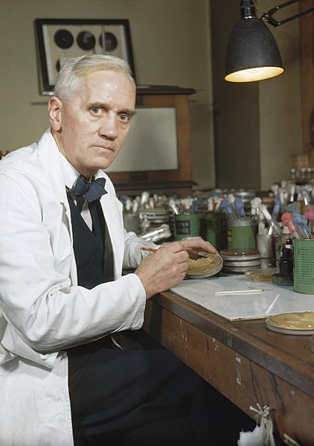
GAS Background
First description attributed to Austrian surgeon, Theodor Billroth in 1874 (“Strepto”=a chain, “coccus”=a berry) [5]
Alexander Fleming, Howard Walter Florey, and Ernst Boris Chain contributed to the development of penicillin, the choice treatment of Strep for decades [5]
Alexander Fleming
Image in the public domain

Slide 4
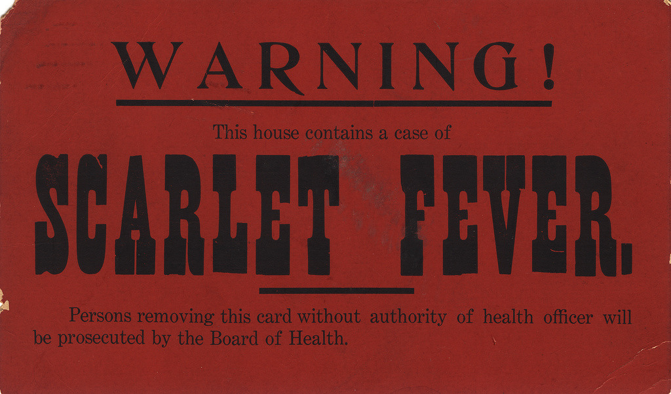


What can GAS cause?
Strep throat
Scarlet fever
Impetigo
Rheumatic fever
Toxic shock syndrome
Cellulitis and necrotizing fasciitis
This Photo by Unknown Author is licensed under CC BY-SA-NC
This Photo by Unknown Author is licensed under CC BY
This Photo by Unknown Author is licensed under CC BY-NC-ND

Slide 5
Strep Throat [6]
Acute infection manifested through sudden soar throat, fever, and painful swallowing (Odynophagia)
Spread most through person-to-person contact (saliva or nasal secretions)
Symptomatic carriers more likely to spread than asymptomatic
Could spread through food
Spread through fomites very unlikely
Humans are primary reservoir
Incubation period: 2-5 days
Diagnosed by RADT or throat culture
Treatment through antibiotics
Individual can return to the world if they are afebrile and if 24 hours into antibiotic treatment
If untreated, one can remain contagious for 2-3 weeks of being asymptomatic [7]
Prevent spread by wearing a mask, washing hands, staying home

Slide 6
Impetigo [8]
A superficial bacterial skin infection
Look like honey-colored scabs
Usually appear on face and extremities
Incubation period, from infection to lesion-development, is about 10 days.
Most common among children between 2 and 5 years old.
Diagnosed by physical exam or lab test
Treated with oral or topical antibiotics
Spread can be prevented
Covering lesions, antibiotic treatment, and good hand hygiene
Practice good hygiene (cover mouth and nose, wash hands, etc.)

Slide 7
Type II Necrotizing Fasciitis [9]
A flesh-eating infection characterized by swelling, tenderness, patchy red skin, and heat
Common to all kinds of people [12]
Diagnosed through symptom-exploring, imaging, surgery, lab tests, etc.
Incubation period: 24 hours after minor injury [11]
Spread through breaks in skin [10]
Cuts and scrapes, burns, insect bites
Can also infect through blunt trauma
Is rarely contagious
Treated through surgery, removal of necrotic tissue, and antibiotics
Notes:
Often, patients presenting with NF have some predisposition to infection. Immunocompromise, advanced age, peripheral vascular disease, and obesity are some predisposing factors. Box 1 lists known risk factors. In a Singapore study, 70.3% of patients with NF had diabetes mellitus.¹ Most patients have a history of trauma, or there might be a history of surgery or penetrating injury. However, the injury can be quite trivial; eg, insect bites or scratches. As in the case we described, NF has even been reported after acupuncture.¹⁵ This type of specific history (further examples of which are summarized in Table 2) is often only obtained if the physician directly questions the patient; otherwise, patients are likely to neglect or forget to mention it.

Slide 8
Summary
GAS is a bacteria that can infect many parts of a human body
GAS can be caught by leaving a wound unclean or just by talking to people
GAS can be prevented by cleaning/treating wounds ASAP and by practicing good hygiene
Wash your hands before handling food
Wear a mask if you must interact with people before you’re not contagious
Don’t use dishes – cup, utensil, etc. – that have already been used

Slide 9
References
[1] Gram Positive Bacteria https://www.ncbi.nlm.nih.gov/books/NBK470553/
[2] Group A Streptococcus https://nccid.ca/debrief/group-a-streptococcus/#:~:text=Group%20A%20streptococcus%20(GAS)%20bacteria,infections%20such%20impetigo%20and%20cellulitis.
[3] Scarlet Fever https://www.cdc.gov/groupastrep/diseases-hcp/scarlet-fever.html
[4] Pathogen Safety Data Sheets: Infectious Substances – Streptococcus pyogenes https://www.canada.ca/en/public-health/services/laboratory-biosafety-biosecurity/pathogen-safety-data-sheets-risk-assessment/streptococcus-pyogenes.html
[5] History of Streptococcal Research https://www.ncbi.nlm.nih.gov/books/NBK333430/#:~:text=The%20first%20description%20of%20streptococcal,1874%3B%20Billroth%2C%201877).
[6] Pharyngitis (Strep Throat) https://www.cdc.gov/groupastrep/diseases-hcp/strep-throat.html
[7] Strep Throat https://www.healthlinkbc.ca/health-topics/hw54745#:~:text=Symptoms%20of%20strep%20throat%20usually,with%20or%20without%20antibiotic%20treatment.
[8] Impetigo https://www.cdc.gov/groupastrep/diseases-hcp/impetigo.html
[9] Type II Necrotizing Fasciitis https://www.cdc.gov/groupastrep/diseases-hcp/necrotizing-fasciitis.html
[10] Necrotizing Fasciitis: All You Need to Know https://www.cdc.gov/groupastrep/diseases-public/necrotizing-fasciitis.html?CDC_AA_refVal=https%3A%2F%2Fwww.cdc.gov%2Ffeatures%2Fnecrotizingfasciitis%2Findex.html
[11] Necrotising fasciitis https://dermnetnz.org/topics/necrotising-fasciitis/
[12] Necrotizing Fasciitis https://www.ncbi.nlm.nih.gov/pmc/articles/PMC2762295/

